Slide 1
Trigger efficiency with UED SS dimuon events
F. Marinho

Slide 2
Overview
UED Model reminder
Motivation for trigger studies
Trigger efficiency vs muon P_{T}
Trigger Paths (Leptonic & Hadronic)
Background

Slide 3
The UED model
All particles are allowed to propagate in the extra dimension
KK number conservation ↔ UED pair production and LKP
Predicts the production of the N=1 modes at LHC energies
Interesting phenomenology. In some aspects similar to SUSY models

Slide 4
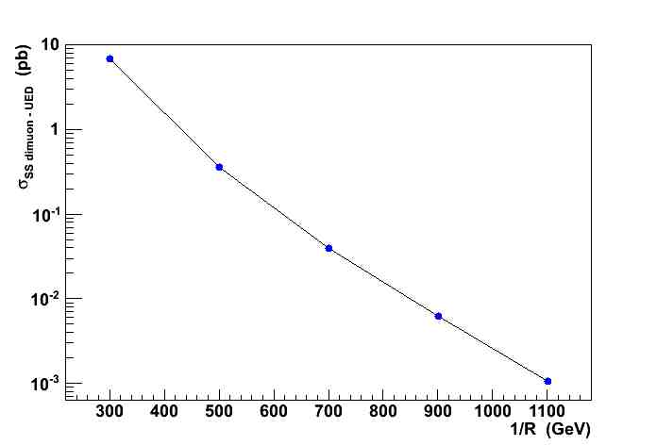
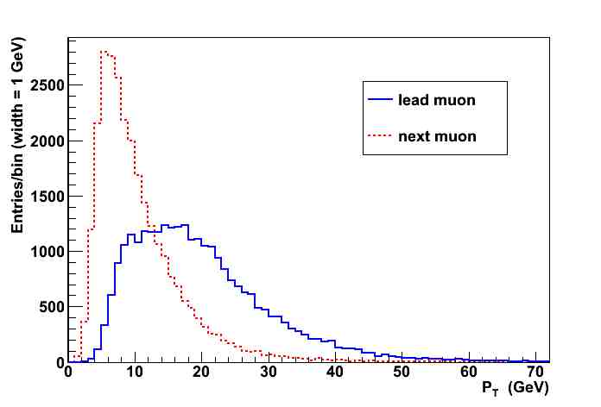
The mUED model
E_{cm} = 7 TeV
Parameters: 1/R, Λ
High XSection values depend on 1/R
P_{T} distributions in the low GeV range
Trigger strategy should not cut those muons
Reconstructed

Slide 5
Data sets
Used CMSSW_3_3_6: Fast simulation with startup setup + trigger
Events generated with Pythia only
UED ss dimuons: 1/R: 300, 500, 700, 900, 1100 ~35000 events per point
ttbar inclusive events 225000 events

Slide 6
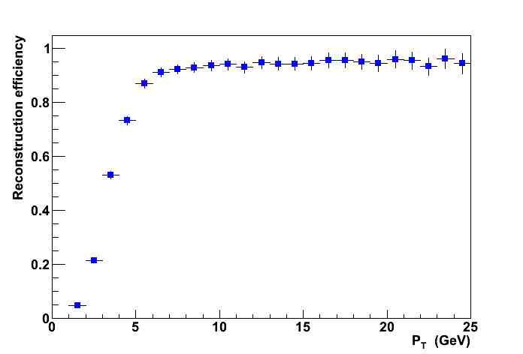
Muon Reconstruction
Reconstruction efficiency as a function of P_{T}
Muons at low range are already suppressed in the reconstruction
Muon requirements:
Prompt, Global,
MC matched
Trigger algorithms should not increase these effects above ∼7GeV

Slide 7
Trigger Efficiency
Throughout this talk:
Only Global Muons are used
Trigger denotes the HLT trigger path used
Efficiencies evaluated for leading and next to leading muons
Both muons reconstructed: 80% of signal kept

Slide 8
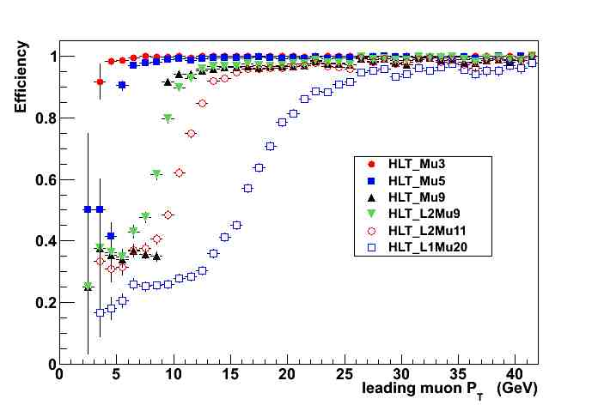
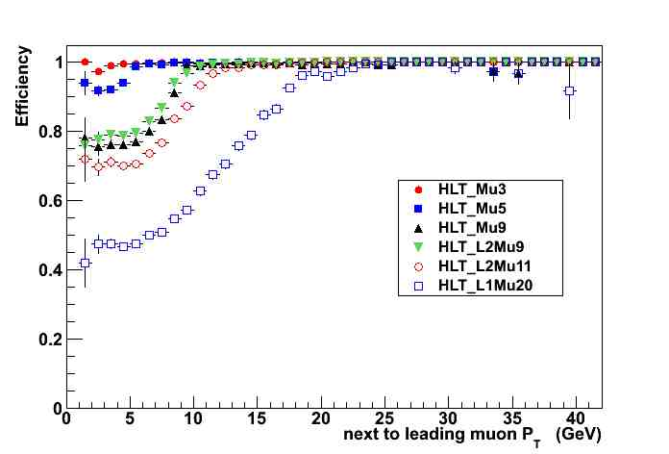
Single Muon Paths
HLT Paths highly efficient for signal
Low P_{T} range not significantly affected by trigger cuts up to 5 GeV
P_{T} cuts should be < 7GeV keeping efficiency above 80% for the next to leading muon
HLT Path | Efficiency
HLT_Mu3 | 0.9981±0.0002
HLT_Mu5 | 0.9889± 0.0006
HLT_Mu9 | 0.939± 0.002
HLT_L2Mu9 | 0.937±0.002
HLT_L2Mu11 | 0.901±0.002
HLT_L1Mu20 | 0.756±0.003

Slide 9
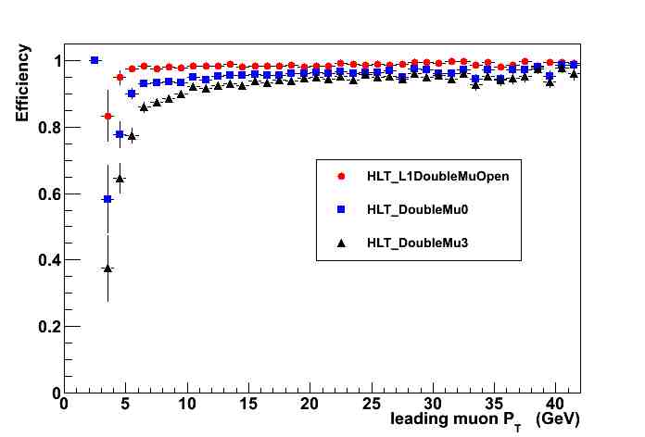
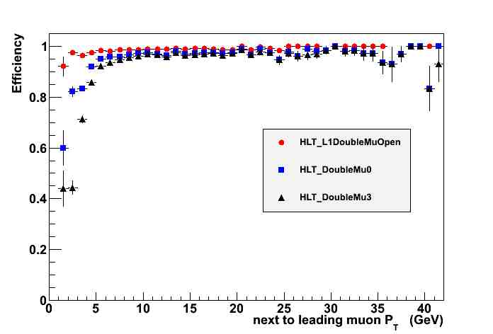
Dimuon Paths
High efficiency paths for signal
Dimuon paths have similar effects on leading and next to leading muons
HLT Path | Efficiency
L1DoubleMuOpen | 0.9840±0.0008
HLT_DoubleMu0 | 0.953±0.001
HLT_DoubleMu3 | 0.929±0.002

Slide 10
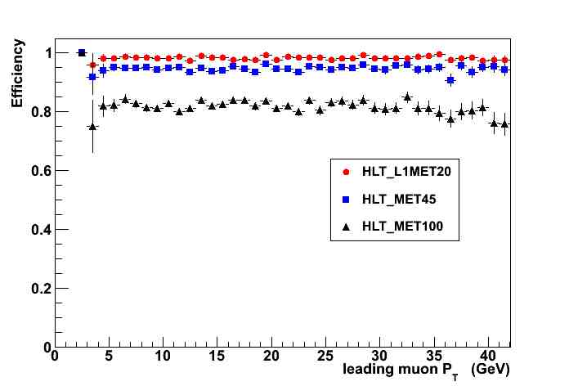
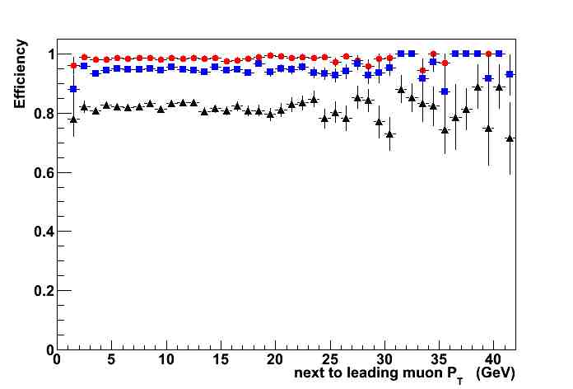
MET Paths
Signal events with distinct MET signature
Two lightest particles
Muons distributions are not distorted
HLT Path | Efficiency
HLT_L1MET20 | 0.9829±0.0007
HLT_MET45 | 0.946±0.001
HLT_MET100 | 0.821±0.002

Slide 11
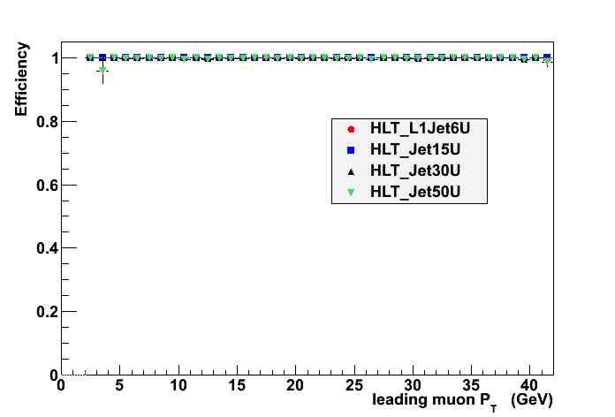
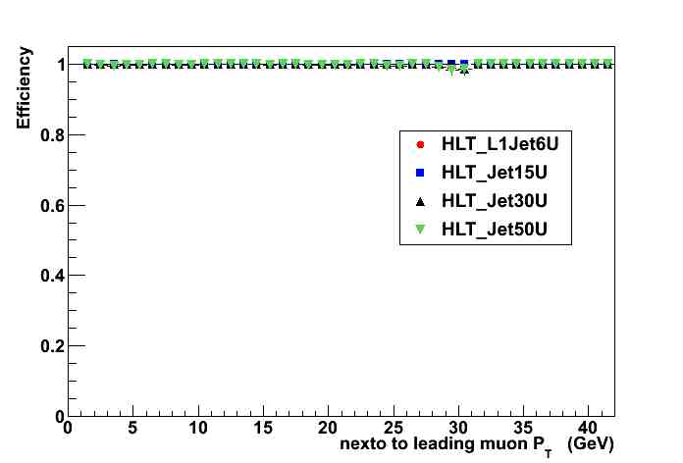
Jet Paths
Signal events with distinct Jet+MET signature
Almost all events were accepted
Muon distributions are recovered
Jet cuts are very loose in these HLT Paths
More interesting to cut on number of jets (offline)

Slide 12
Background ttbar
5% of events with SS dimuon
Suppression due to REC and charge requirement
Lead muons from W’s and b’s
Next to lead muons from hadronic
No isolation or other cuts are applied

Slide 13
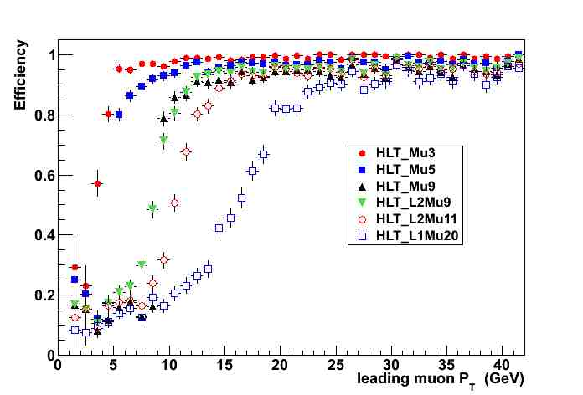
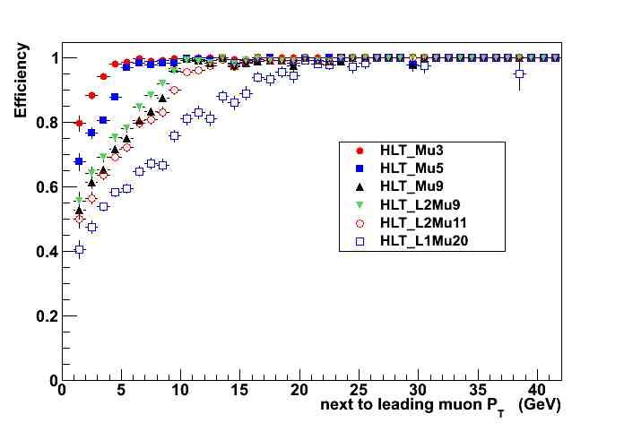
ttbar - Muon Paths
Distributions similar to signal
But efficiencies are lower
HLT Path | Efficiency
HLT_Mu3 | 0.977±0.001
HLT_Mu5 | 0.939±0.002
HLT_Mu9 | 0.849±0.003
HLT_L2Mu9 | 0.868±0.003
HLT_L2Mu11 | 0.830±0.004
HLT_L1Mu20 | 0.733±0.005

Slide 14
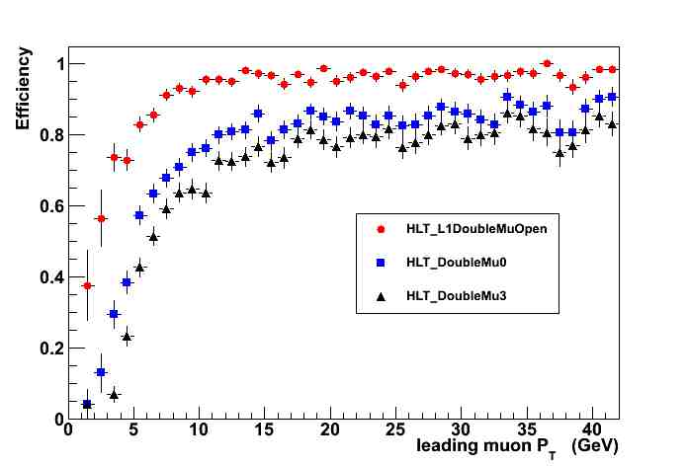
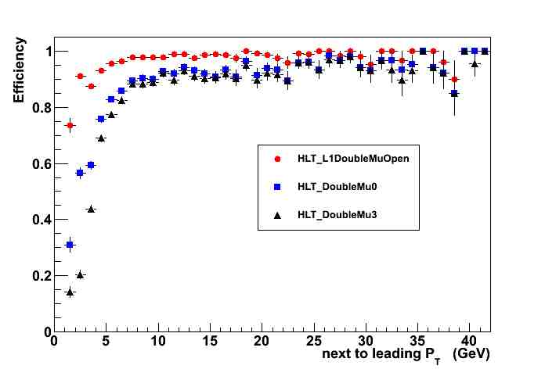
ttbar – Dimuon Paths
Similar distributions
Lower plateaus
HLT Path | Efficiency
HLT_L1DoubleMuOpen | 0.950±0.002
HLT_DoubleMu0 | 0.837±0.004
HLT_DoubleMu3 | 0.813±0.004

Slide 15
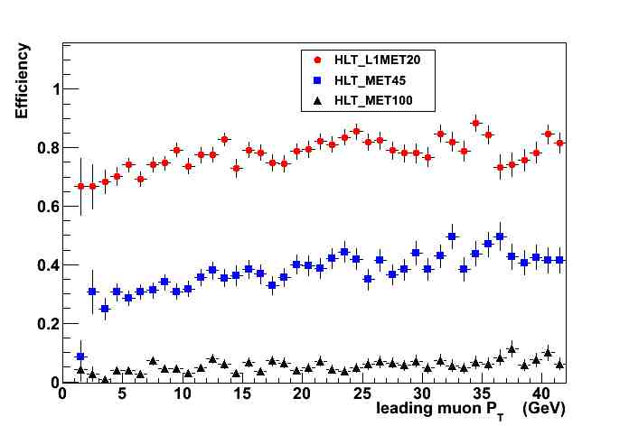
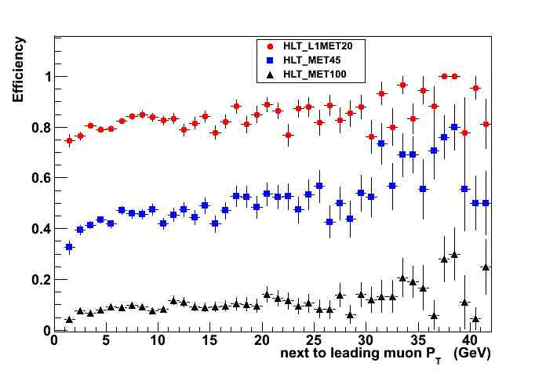
ttbar – MET Paths
Low P_{T} correlation
Good path for robustness check?
Background highly suppressed
Use as offline selection variable
HLT Path | Efficiency
HLT_L1MET20 | 0.818±0.004
HLT_MET45 | 0.458±0.007
HLT_MET100 | 0.108±0.009

Slide 16
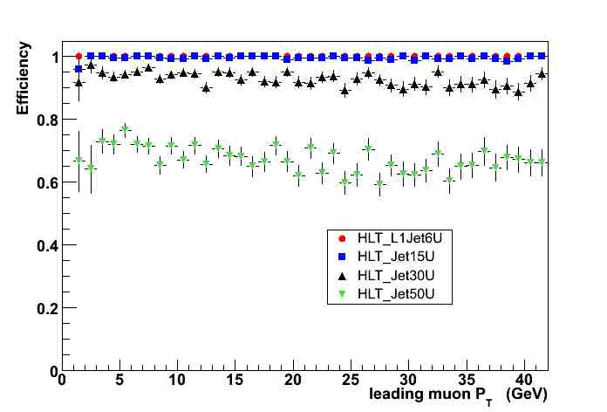
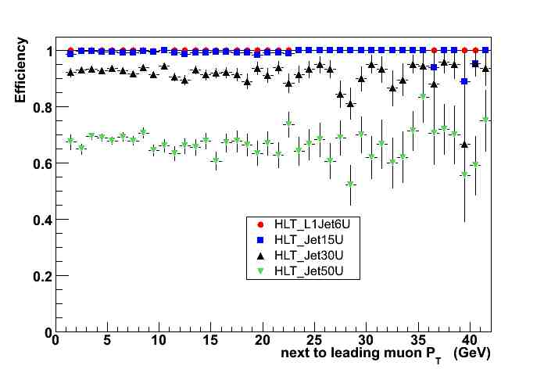
ttbar - Jet Paths
No P_{T} correlation
Good path for robustness check?
Background partially suppressed
Use as offline selection variable
HLT Path | Efficiency
HLT_L1Jet6U | 0.9998±0.0001
HLT_Jet15U | 0.9950±0.0006
HLT_Jet30U | 0.926±0.002
HLT_Jet50U | 0.677±0.005

Slide 17
Summary
SS dimuon analysis promising already at startup possible to scratch current 1/R lower limit
Avoid acceptance effects for muon distributions at least on offline level
Muon triggers for startup data employed.
Consider hadronic Paths for robustness purposes.
MET and Jets are interesting as offline selection variables.

Slide 18
Next
Offline selection
Improve background studies
Determine yields at 7 TeV
Yields vs model parameters
Same exercise for other leptons (anyone interested ???)

